Slide 1
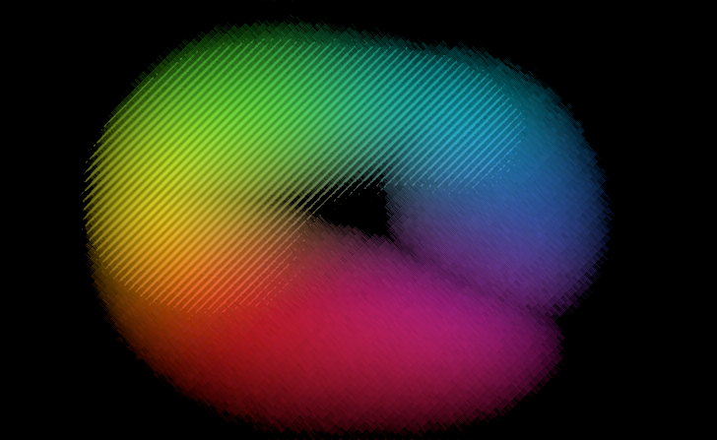
BY:
RICHARD
Light
&
Photography
In physics

Slide 2


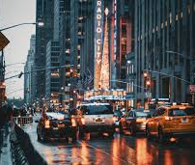




Slide 3

Why do we see these wonderful moments being captured?
To understand the theory behind it, lets look at what is
LIGHT
Light is an electromagnetic wave/photons**
We usually talk about it as visible spectrum

Slide 4




























What are electromagnetic waves?
Particles with electro charges releases an electric field around it:
Magnetic fields always appears North to South

Slide 5


































What if the field starts to move at a direction?
A moving magnet at one direction can produce an electric field

Slide 6
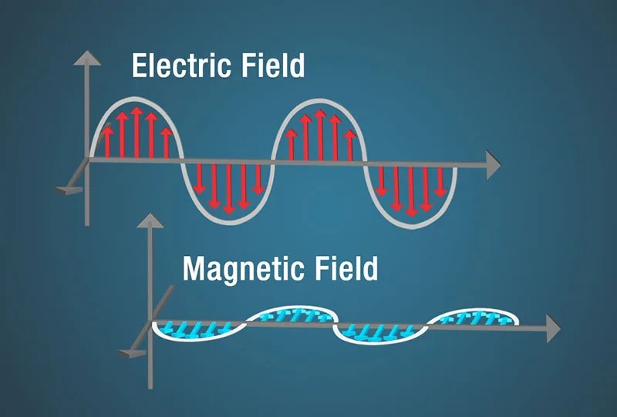
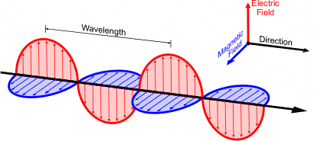



















































































































































































































































How electromagnetic waves form:
Because of the electromagnetic effect, a moving electro charge/field will build a magnetic field and a magnetic field will then build a electro field.
On and on and on……
Forming a perpendicular oscillate between the two fields, forming electromagnetic waves.

Slide 7
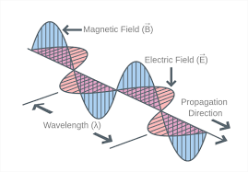
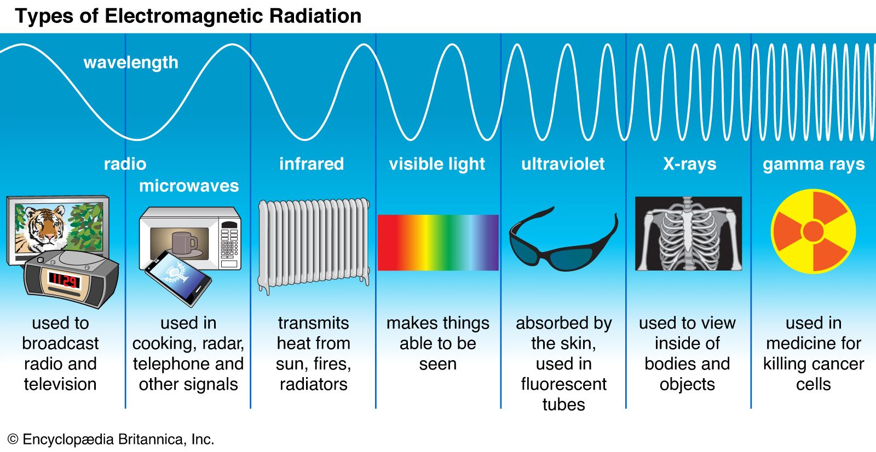
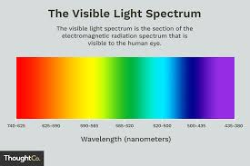

Wavelength and Frequency
Wavelength λ. (lambda) : Distance between two crests or troughs.
Frequency (f): Number of waves passing a point per second.
Wave Speed Equation: c=λf

Slide 8
































Why do we see objects in different color?

Slide 9







The reflection and absorption to light of objects
When light hits an object, the object can:
Reflect certain wavelengths.
Absorb certain wavelengths.
Transmit light (if it is transparent).
Examples
An object's color depends on the wavelengths it reflects:
  A red apple reflects red wavelengths and absorbs all other colors.
  A blue shirt reflects blue wavelengths and absorbs the rest.
  A white object reflects all visible wavelengths equally.
  A black object absorbs nearly all visible wavelengths, reflecting very little light.
Why is the Sky Blue?
The blue color of the sky results from Rayleigh scattering, where shorter wavelengths (blue) are scattered more than longer wavelengths (red) by air molecules.

Slide 10
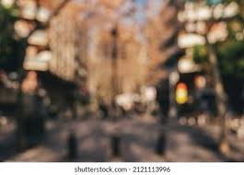
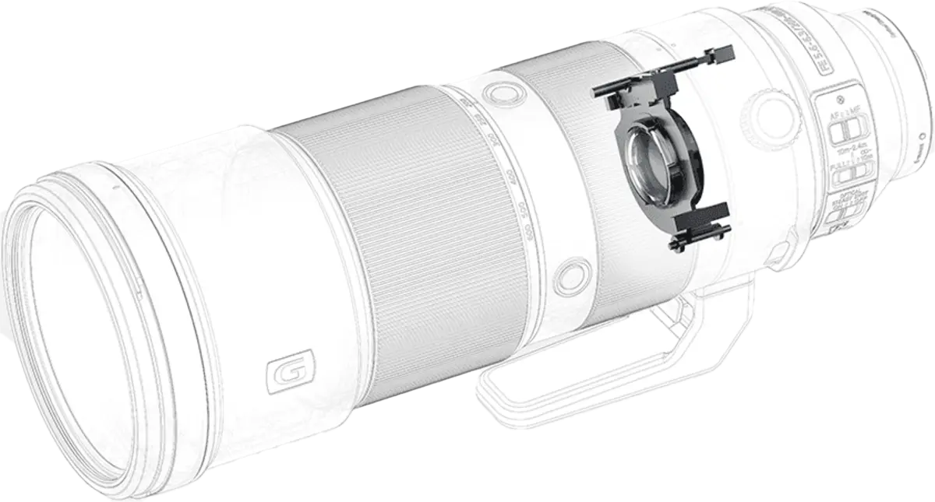
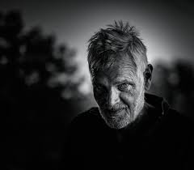























How does a camera focus on objects

Slide 11










































Key concepts of camera lens

Slide 12






















Key concepts of camera lens

Slide 13





















The lens variables

Slide 14


















The lens formula
The lens formula can calculate the distance of how the focusing lens is going to move to achieve a focused image
The formula is:
Here is the example:
$$\frac{1}{f}=\frac{1}{u}+\frac{1}{v}$$
f: Focal length of the lens
u: Distance between the object and the lens.
V: Distance between the lens and the image sensor (or film).

Slide 15
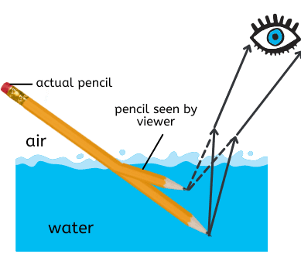
Refraction of light
Refraction of light is the bending of a light wave as it passes from one medium into another with a different optical density, resulting in a change in its speed and direction.

Slide 16















































More about refraction

Slide 17








































Let's look at Snell’s law
Formula:

Slide 18
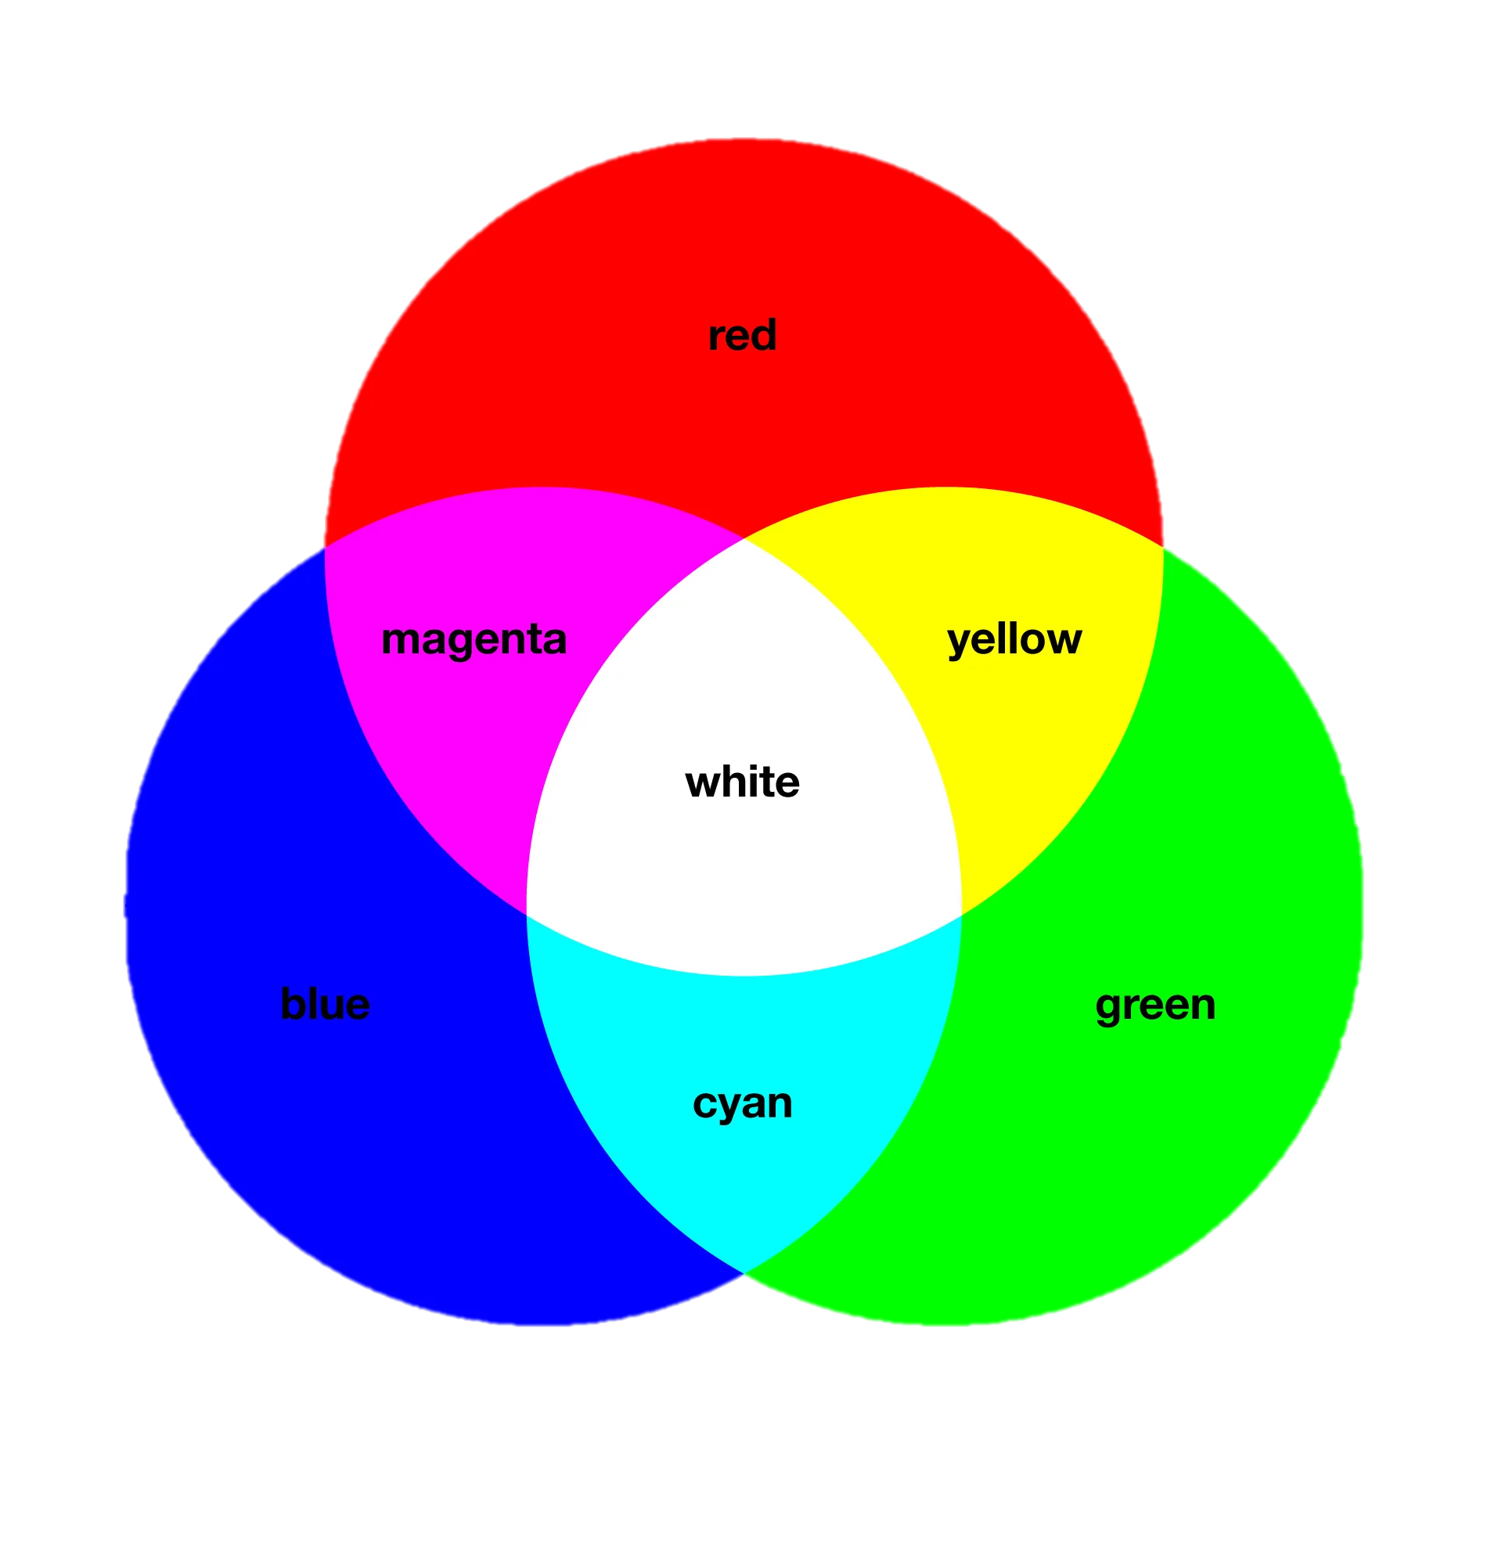
Let's look at optical primary colors
The color we see in daily life can all be built by the three optical primary colors, RED, GREEN and BLUE (RGB) in different brightness.
The primary colors create all the other color by color mixing principle.
Look at an 8-bit photo. It means that each (RGB) color has 0-255 brightness levels (256 in total).
0 represents lowest brightness, meaning black. 255 represents the highest brightness, meaning the most vivid.

Slide 19






Let’s look at some examples of primary colors
#41939c
RGB: 65, 147, 156
#b5264a
RGB:181, 38, 79
#b39334
RGB: 179, 147, 52
#6f28c7
RGB: 111, 40, 199
#46b058
RGB: 70, 176, 88
#2e28c9
RGB:46, 40, 201

Slide 20
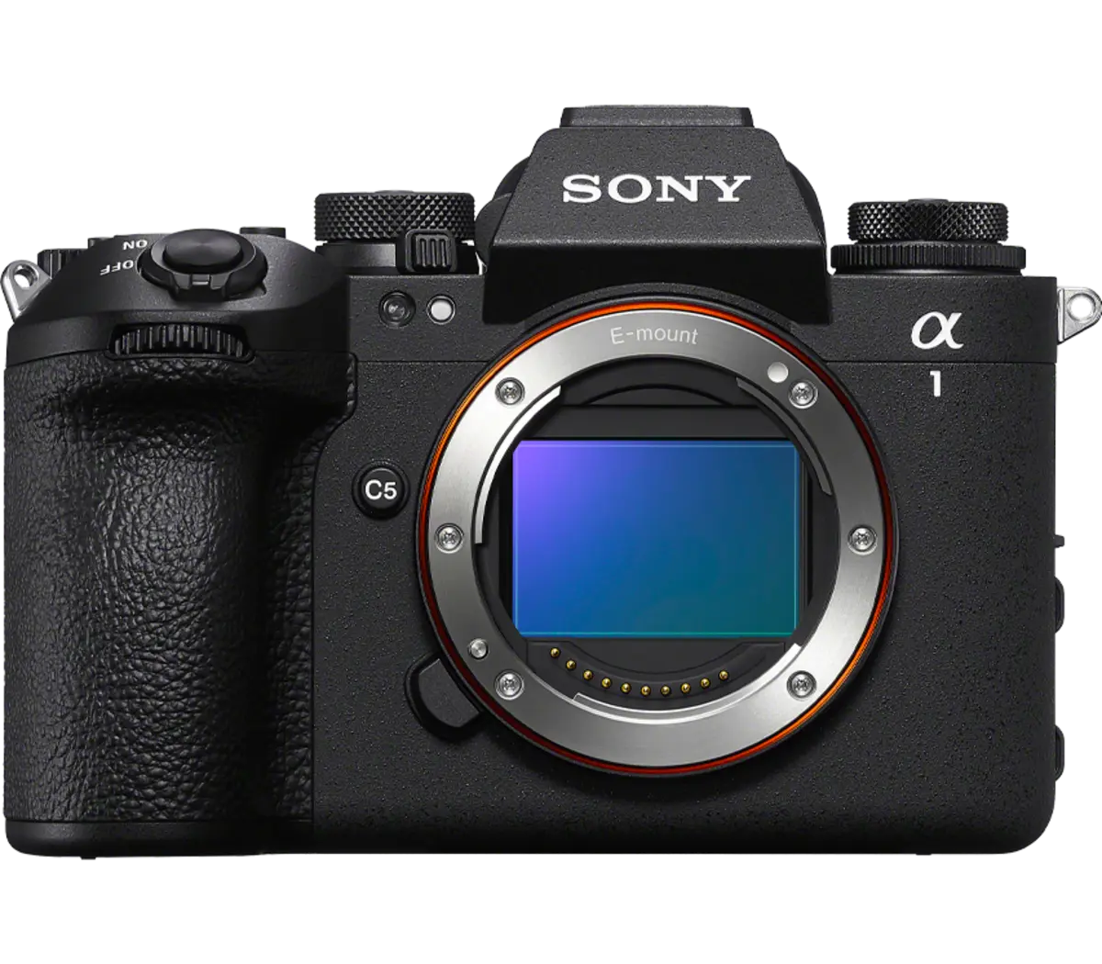
How does the camera sensor work?
The camera’s sensor is the most sophisticated part in the camera, it absorbs light energy and convert it into electric energy by photodiode.
The camera’s sensor is equivalent to human’s retina.
Most camera nowadays uses the CMOS sensor, (complementary metal oxide semiconductor). Which has a faster readout speed than old CCD sensors

Slide 21






















This is Sony alpha 1 mark 2
The camera just released in November 2024

Slide 22











How does a pixel look on the sensor?
Infront of the photodiode which captures light, there is a colored piece of glass called the optical filter. Which “filters” the specific wavelength of RED, GREEN or BLUE.
This is because the sensor cannot deal with every-single color in the world but capture down the relative brightness of RGB and then stitching the color signals together in the chip to revert the original color.
Here is a sketch map of a pixel on a sensor:
Bayer filter:
We can find out that the ratio between the Green, Red and Blue color filter is 2:1:1
This is because human’s eyes are more sensitive to green than to blue and red. Therefore, the camera needs to ”simulate“ the color scene for human.

Slide 23






























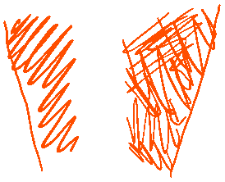


















What does a unit of a pixel look like?

Slide 24







































Dug deep to N type semiconductor
This is the silicon crystal, the four valance electrons of each silicon atom combine with the four from the other atom. Forming a stable structure.
This is the N-type semiconductor doped with phosphorous

Slide 25










Dug deep to P type semiconductor
This is a silicon crystal doped with boron, appearing a “hole” to complete the covalent bond. Other electrons will keep filling this hole, leaving new holes. You can imagine the hole is moving
This is the silicon crystal, the four valance electrons of each silicon atom combine with the four from the other atom. Forming a stable structure.

Slide 26












What happens when we put a N-type & P-type semiconductor together

Slide 27










What happens when we put a N-type & P-type semiconductor together

Slide 28















What happens when we put a N-type & P-type semiconductor together

Slide 29

















What happens when we put a N-type & P-type semiconductor together

Slide 30












Reverse biasing to increase stability

Slide 31












Reverse biasing to increase stability

Slide 32

































What if light shines on the P-N junction
To understand this, we will look a bit further on the band theory of solids.

Slide 33
















What if light shines on the P-N junction

Slide 34









What if it’s a large crystal with so many energy levels?

Slide 35





At the topmost energy level of a atom in perspective of a large crystal:
We can see there are two bands here. The valence band and the conduction band. The valence band has electrons that has less energy and attracted by the nucleus. But the conduction band has electrons that has higher energy, which is about to breakaway the attract of the atom and become free electrons.

Slide 36































Band gaps of conductors, semiconductors and insulators:

Slide 37

















Now let’s come back to silicon, the material of camera sensors.
The formula of the energy a light wave contain is given by:
$$E=\frac{hc}{λ}$$
Where :
h = Plank’s constant: $6.626∗{10}^{−34}Js$
c = speed of light in vacuum: $3∗{10}^{8}m/s$
$λ$ = wavelength in meters.
1eV = $1.602∗{10}^{−19}J$

Slide 38
















Let’s look at an example:
Blue light has wavelength close to 450nm
$$E=\frac{hc}{λ}$$
Use photon energy formula:
Substitute:
Convert:

Slide 39




















Let’s now move back to the photodiode

Slide 40




























Let’s now move back to the photodiode

Slide 41

































Now a current is formed

Slide 42
Congratulations, now you’ve known the whole process of how a digital camera produces an image ☺

Slide 43
Thankyou for listening

